Slide 1

A
Project Report
On
“MIS for Children Vaccination”
(MCA - 601)
Submitted in partial fulfillment for the requirement for the
Master of Computer Applications
Semester : MCA VI
From
Pt. Ravishankar Shukla University, Raipur (C.G)
Session: 2021-22
Internal Guide :
Dr. Sanjay Kumar
(Professor, Head & Dean)
S.o.S. in Computer Science & I.T.
Pt. R.S.U. Raipur (C.G)
Presented By :
Megha Rao
Roll No. 1910174011
Enroll No.: ZZ/56481
Submitted to
S.o.S. in Computer Science & I.T.
Pt. Ravishankar Shukla University, Raipur (C.G.)

Slide 2

Contents
Introduction
About The Company
About The Project
System Analysis
Drawbacks
Objective
Module Description
Software and Hardware Requirements
Data Flow diagram
Flowchart
Entity relationship Diagram
Database Design
Input-Output Screen
Report
Future Enhancement
Limitation
Conclusion
References

Slide 3

About The Company
SIRMOR SOFTWARE SOLUTION PVT. LTD
Founded in 2014
Include a detailed, colorful syllabus for parents to take home.
It provides Error-free codeing, picture perfect websites, fully customised wbsites.
They are very professional but very supportive.

Slide 4

About The Project
Young children are at increased risk for infectious diseases because their immune systems have not yet built up the necessary defences to fight serious infections and diseases.
Vaccinations start early in life to protect children before they are exposed to these diseases.
The proposed system of MIS for Children Vaccination provide proper schedule of children vaccine time interval
MIS for Children Vaccination is a web application which is implemented in Codeigniter4 Framework and PHP.
It manages all the hospital data.

Slide 5
System Analysis
Existing System
Vaccines are provided for infants and childrens from various aspacts such as going to school manually. There is a chance tha some chilren and infants may miss the oppurtunity of vaccination due to copiling reasons.
It is a time delay proccess for which everyone has to wait everywhere.
It would be difficult for the to handle multiple child data and creating and maintaining a vaccination schedule for child used to be difficult task at the same time.
When there are many child, the paper work for the hospital staff increased greatly, due to which he used to collect a lot of data in the form of paper. It is also a challenge for the hospital staff to keep all the paper works related to his account.

Slide 6
Proposed System
Maintains the data of registred children.
Monitoring the number of vaccines.
Provides vaccination schedules.
Helps in management tasks.
To Transform the manual process to an online and computerized system.
Easy to maintain in future prospect.
Easy to Update the wrong entry.
Reduse the paper work.
System Analysis

Slide 7
Hardware and Software Requirment
Hardware Requirment
Microprocessor - Pentium 1 of higher Drive - Any of the external write able drive (for setup of the package also to take regular backup) HDD - Min 1GB (for operating system & program to setup Properly) RAM - 1 GB (Min.) Display - HDMI/VGA or higher Key Board - 84/109 keys Mouse - Any standard Mouse Printer - 80/132 cols.

Slide 8
Hardware and Software Requirment
Software Requirment
Web Presentation : HTML, CSS
Development Framework : Codeigniter4
IDE : Visual Studio Code
Programming Language : PHP
Database Connectivity : MYSQL
Backend Database : Mysql(Xampp Server)
Operating System : Windows 7(64 bit) or above
Web Server : Xampp Server
Supported Browsers : Google Chrome / Firefox / Opera / Internet Explorer

Slide 9
Super Admin Modules
State Master
District Master
It creates the District.
City Master
Hospital Registration
It creates the City.
It register the Hospital.
It creates the State.
Modules

Slide 10
Department Master
It adds the Doctor.
Doctor Master
It adds the Staff.
Staff Master
It registers the Child.
Child Registration Master
It creates the Designation.
Designation Master
It creates the Department.
Vaccine Master
It creates the Vaccine.
Vaccination Schedule
It creates the Vaccination Schedule.
Vaccinatetion
It maintain the Child Vaccination Schedule.
Reschedule
It reschedule the Vaccination Schedule.
Vaccinated
It saves the vaccination Information
View Vaccinated Report
It displaya the vaccination Report.
Admin Modules

Slide 11
dateOfBirth
consultantDoctorName
childName
gender
dateOfBirth
timeOfBirth
staffName
staffFatherName
gender
childRegistrationNumber
email
address
staffId
email
localAddress
childId
sId
joiningDate
stateId
Child Registration
Staff
stateId
stateId
Has
Vaccinates
Manage
vaccineId
vaccineScheduleId
vaccineScheduleId
ER Diagram
childRegistrationNumber
dateOfVaccination
Vaccination Schedule
Has
Vaccinated
vaccineId
dateOfVaccination
doctorId
Has
childRegistrationNumber
staffId
Has
Consult
Doctor
stateId
stateId
Vaccine
doctorId
joiningDate
prevent
vaccineId
localAddress
Id
vaccineName
doctorName
email
qualification
compostion
physicalForm
gender
dateOfBirth

Slide 12
Super Admin
Login
Take Hospital Details
FlowChart
If Data inserted successfully
False
True
Hospital Registration
Logout

Slide 13
Admin
Login
If Valid ?
False
True
If Login for the 1st time
Change Password
False
If success
Old/New
New
FlowChart
Old
Reschedule
Add Child Details
Create Schedule Vaccination
If Took from Other hospital
True
Vaccinated from Other hospital
False
Elseif Remove Child
True
Child is died
False
True
Vaccinated
Generate Report
Logout

Slide 14
0 LEVEL
Baby Immunization System0
Response/Software settings
Response
Data flow Diagram
User
Admin
Request For Login
Login Request

Slide 15
1 LEVEL
Request to Login Admin
1.0
Match user
Super Admin
Process of
Login
Login Success massage
Response
Add Hospital User
1 Login
Get Hospital Data
1.1
Store Hospital Data
Hospita Admin
Process of
Hospital Registration
1 Hospital
Send Hospital Registration
Response
Data flow Diagram
1.2
Process of Child Registration
1 Child Registration
Request For Vaccination
Store all scheduling Details
1.3
1 Vaccination Scheduling
Process of Vaccination Scheduling
Scheduling
1 Vaccinated
Store Child Data
Generate Report
Vaccination
1.5
1.4
Store Vaccine data
1 Vaccine
Store all Details

Slide 16
Super Admin (2 LEVEL )
Request to Login Admin
Process of
Login
2.0.0
2 Login
Admin
Login Success massage
Response
Manage list of Registered Hospitals
2.0.1
Store hospital data
Data flow Diagram
2 Hospital
Show hospital data
Logout
2.0.2

Slide 17
Admin (2 LEVEL )
Process of
Login
Login Success
Admin
2.1.0
2 Login
Manage All Database
2.1.1
Store Doctor Data
Store Staff Data
2 Doctor
2 Staff
Store Doctor Data
Staff Data
2 Vaccine
Store Vaccine Data
Process of Child Registration
Data flow Diagram
2.1.2
Display Child Data
2 Child
Store Child Data
Vaccination Schedule
Store Vaccination Data
2.1.3
2 Vaccination
Schedule
2 Vaccinated
Generate Report
Store Data
Get Data
Vaccinated
Generate Report
2.1.4
2.1.5
Logout
2.0.6

Slide 18
Admin (2 LEVEL )
Process of
Login
Login Success
Admin
2.1.0
2 Login
Manage All Database
2.1.1
Store Doctor Data
Store Staff Data
2 Doctor
2 Staff
Store Doctor Data
Staff Data
2 Vaccine
Store Vaccine Data
Process of Child Registration
Data flow Diagram
2.1.2
Display Child Data
2 Child
Store Child Data
Vaccination Schedule
Store Vaccination Data
2.1.3
2 Vaccination
Schedule
2 Vaccinated
Generate Report
Store Data
Get Data
Vaccinated
Generate Report
2.1.4
2.1.5
Logout
2.0.6

Slide 19
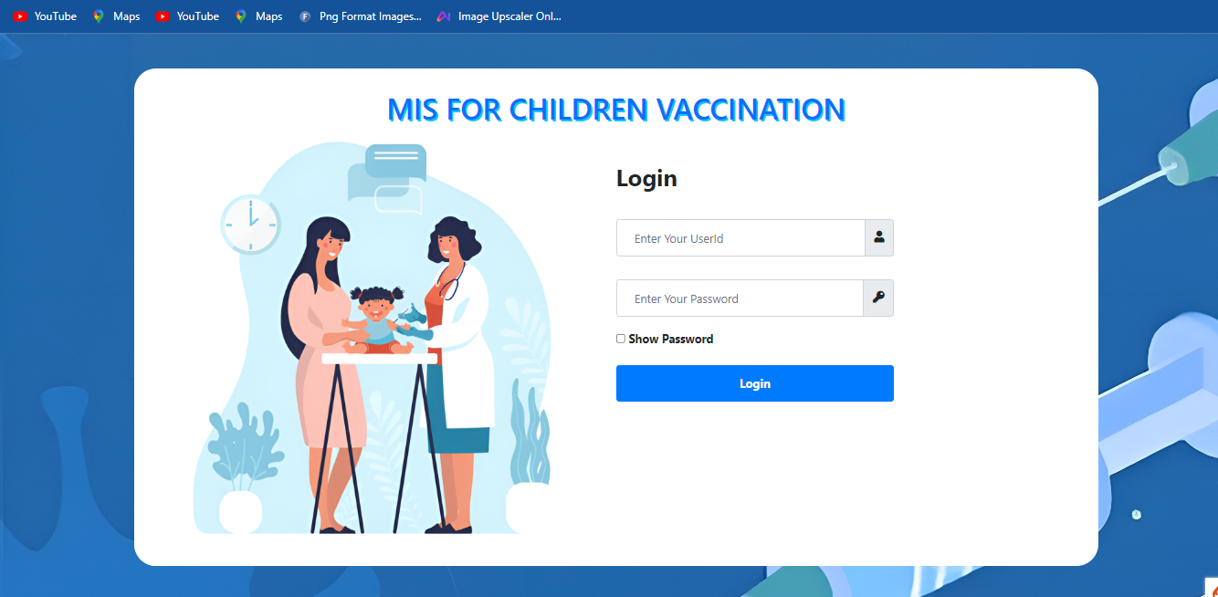
Login Form - Authenticated users login through this module.
Input- output Screen

Slide 20
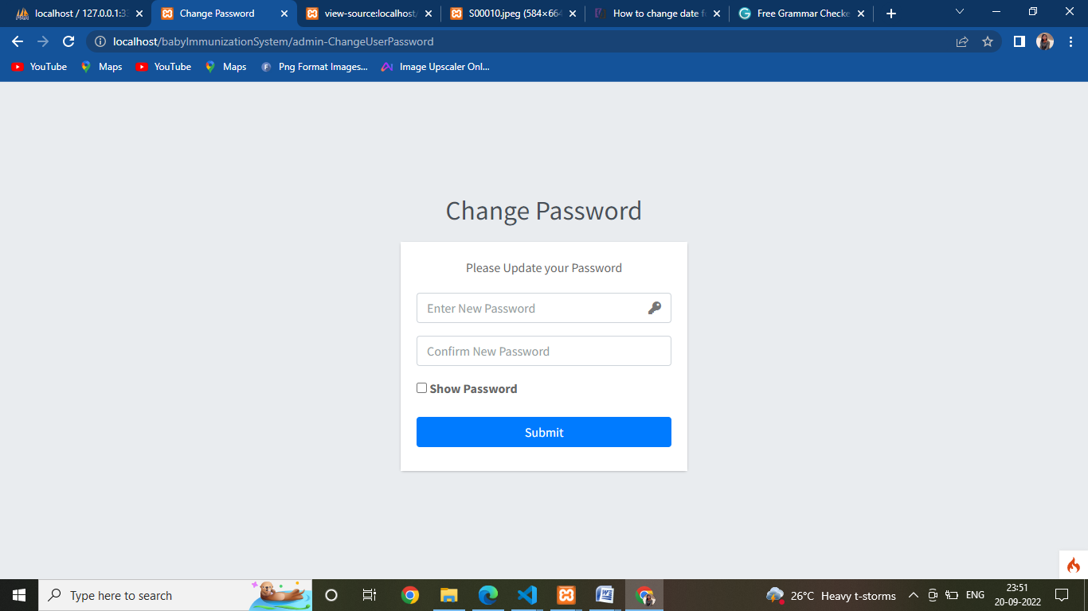
Change Password

Slide 21
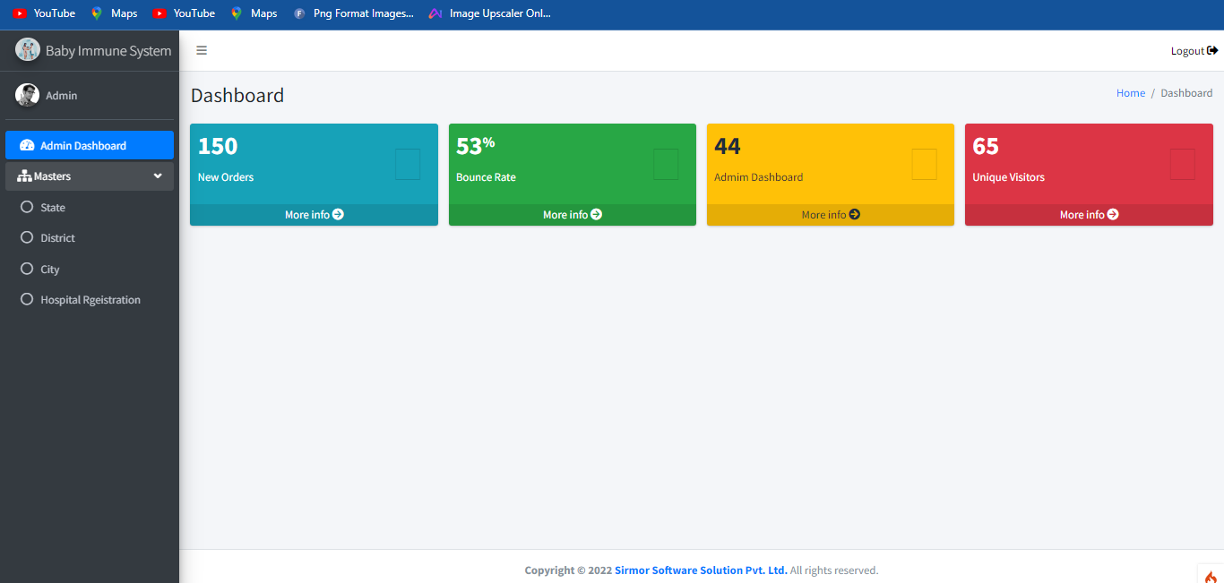
Super Admin Module - Dashboard

Slide 22
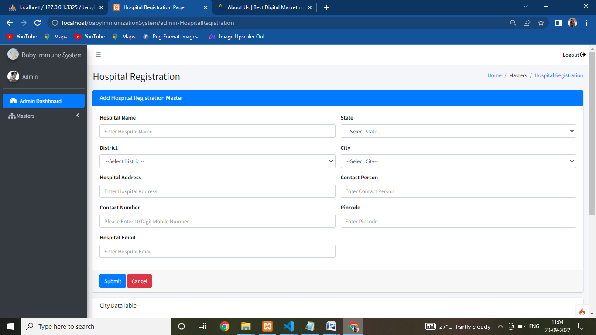
Hospital Registraion

Slide 23
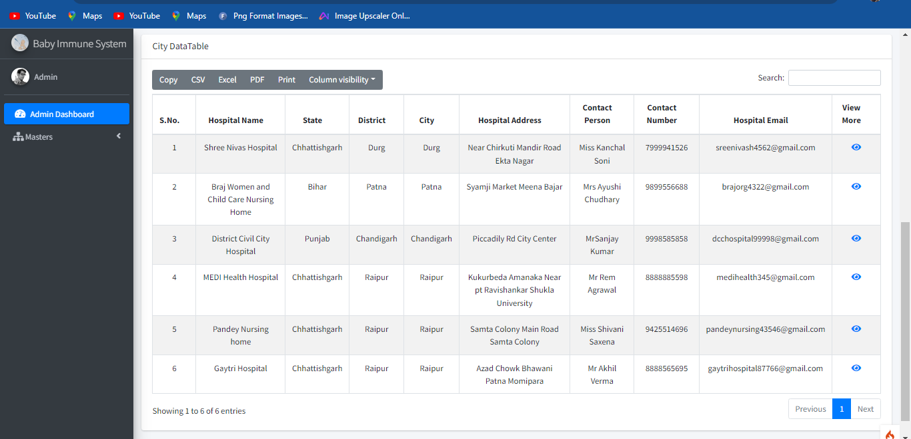
Hospital Registraion Master And Report

Slide 24

Admin Module - Dashboard

Slide 25
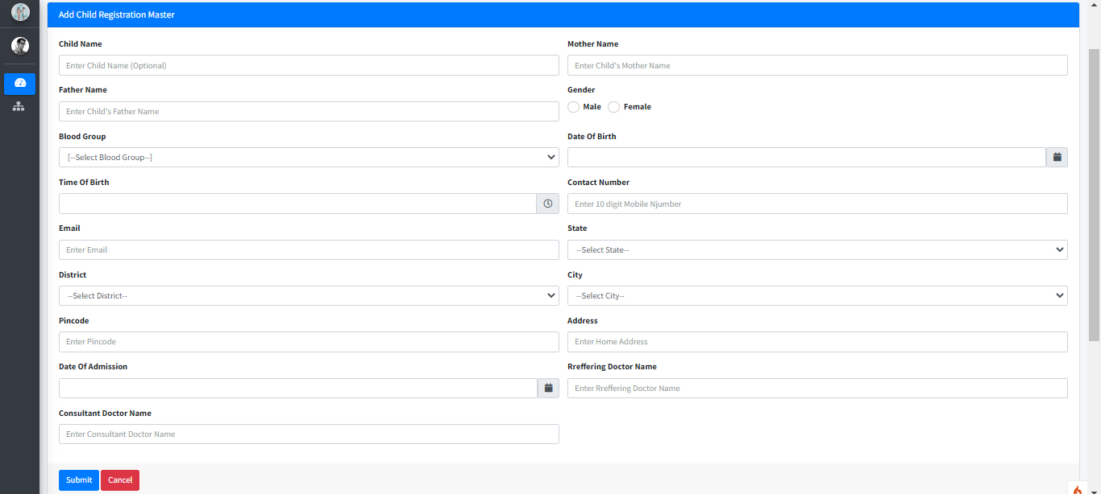
Child Registration

Slide 26
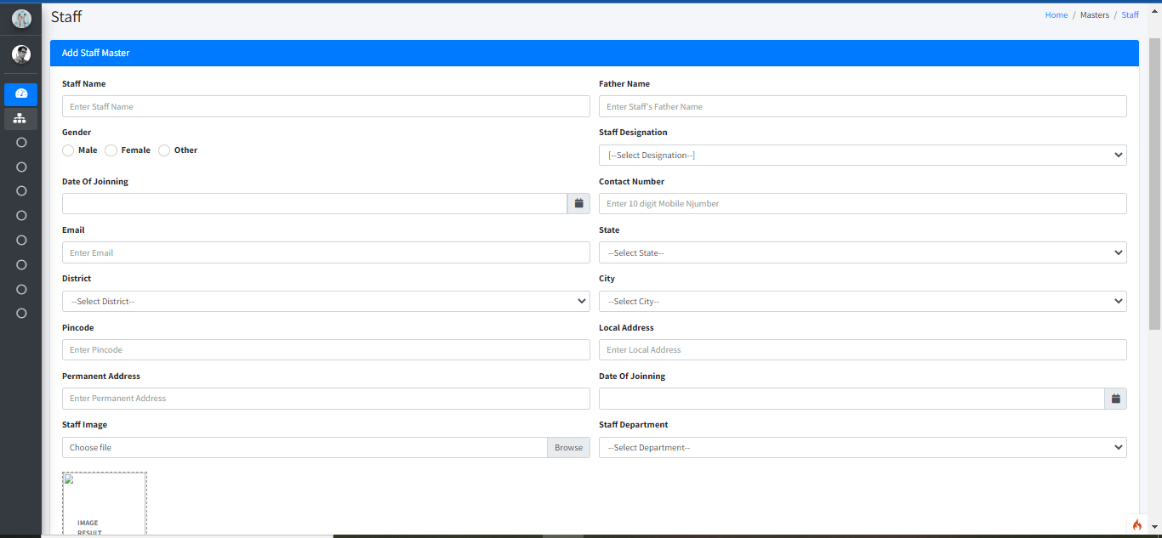
Staff

Slide 27
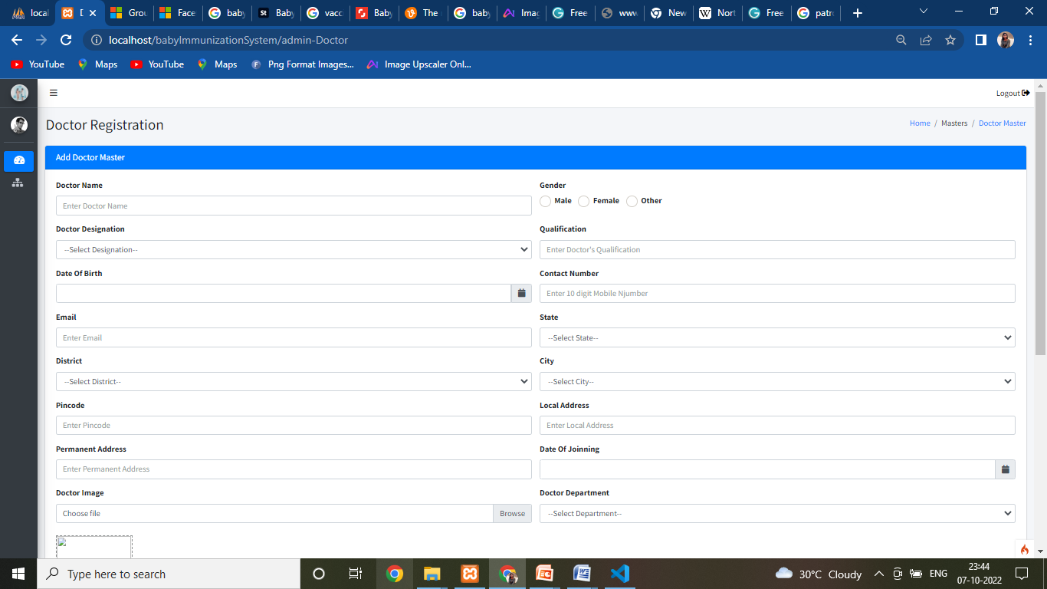
Doctor

Slide 28
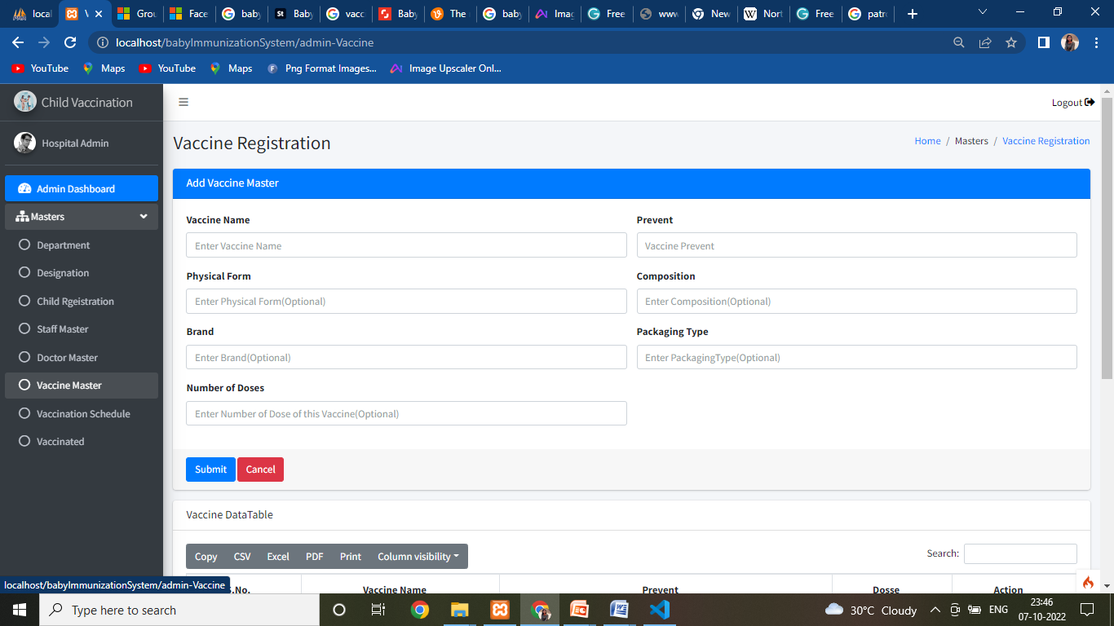
Vaccine Master

Slide 29
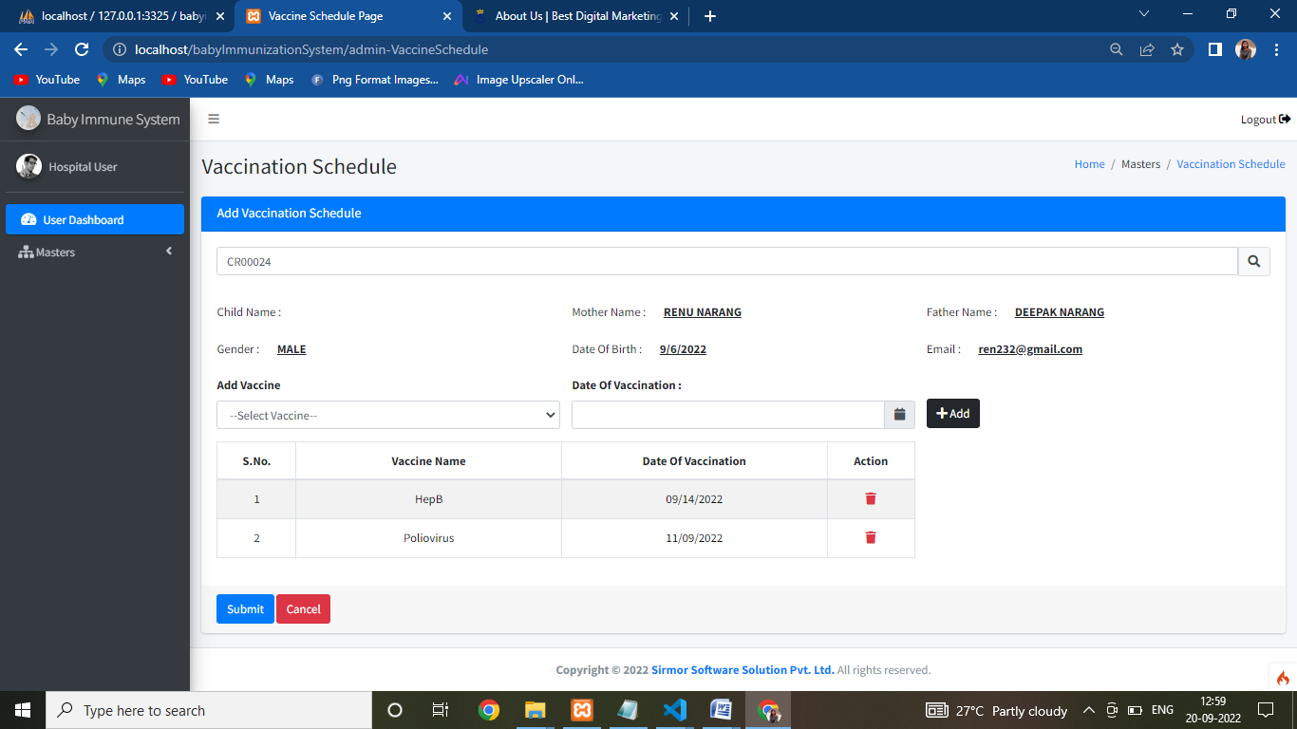
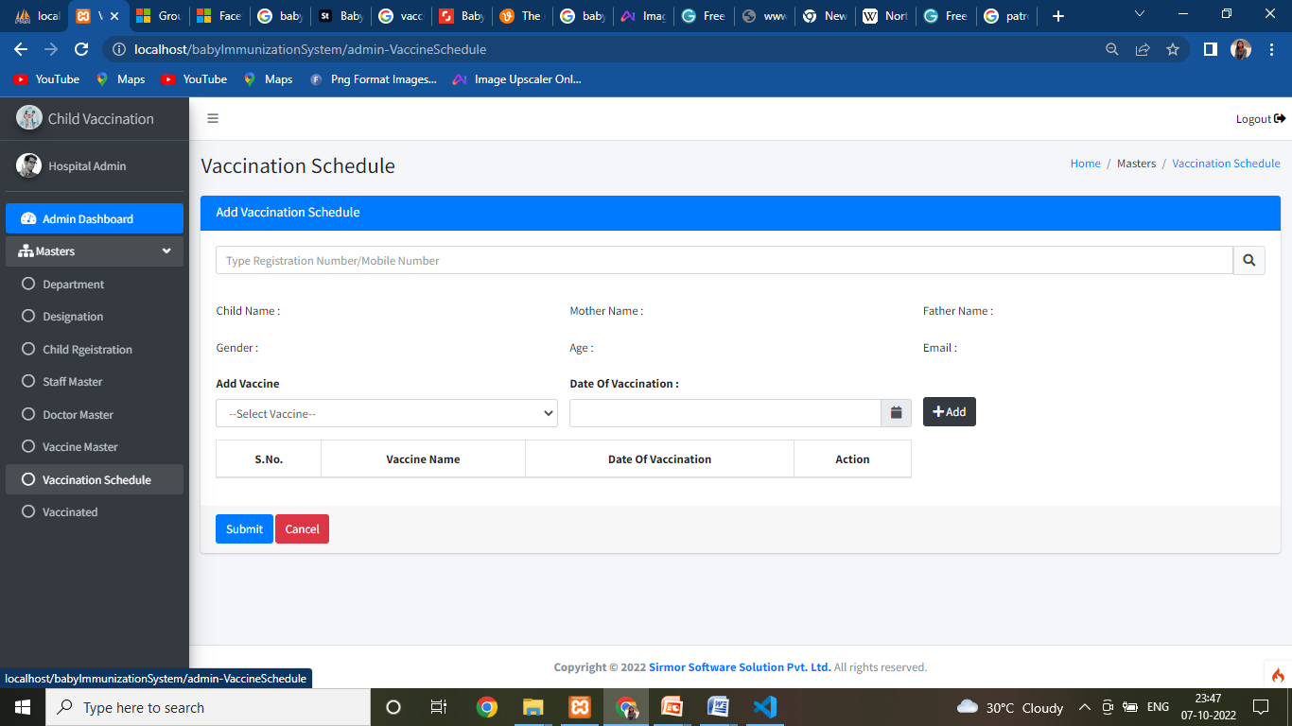
Vaccination Schedule

Slide 30
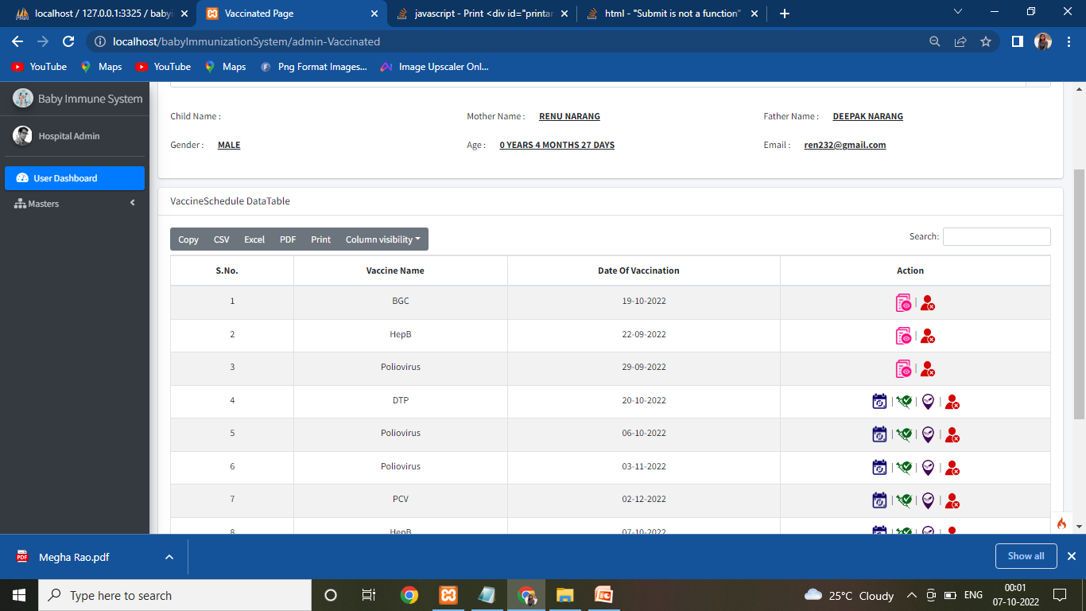
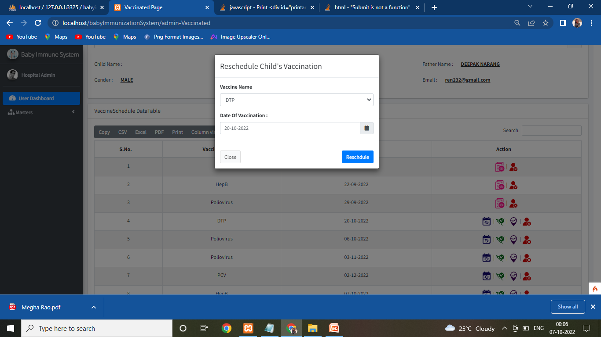
Reschedule

Slide 31
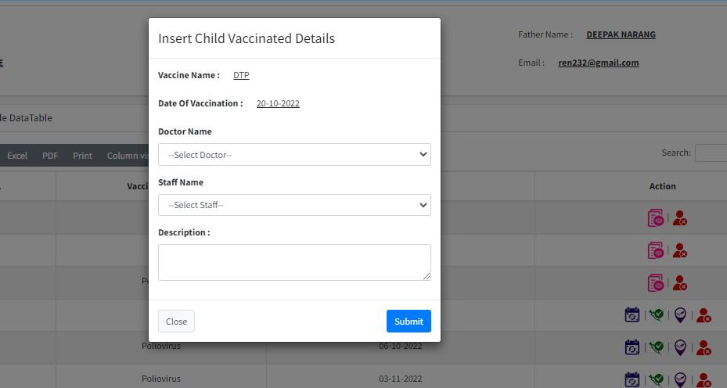
Insert Child Vaccinated Details

Slide 32
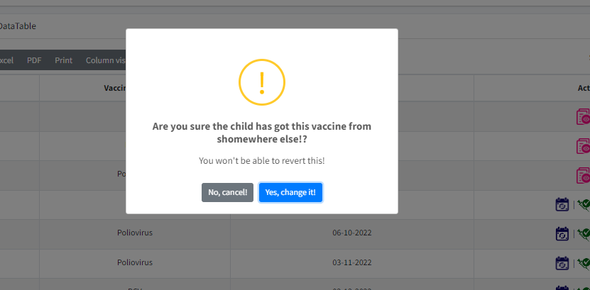
Child Vaccinated from other hospital

Slide 33
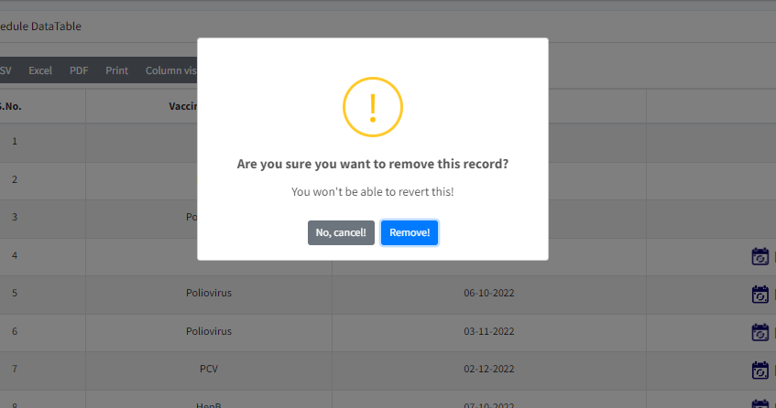
Remove Child If Child has died

Slide 34
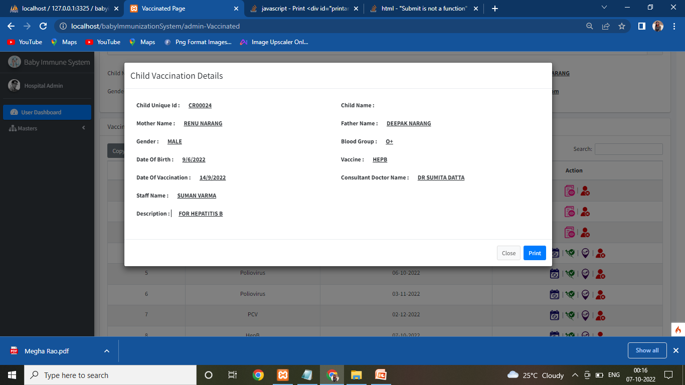
Reports -
Child Vaccinated Report

Slide 35
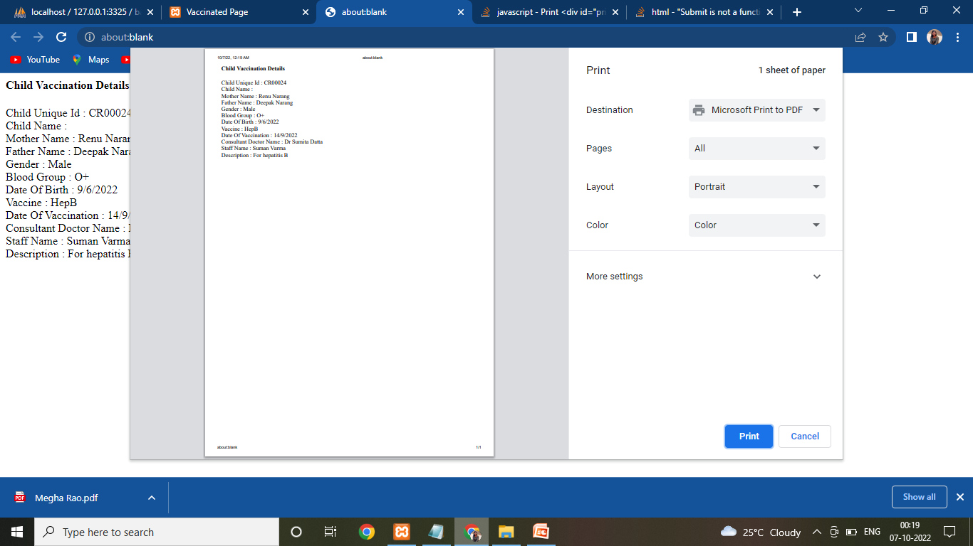
Print Report

Slide 36
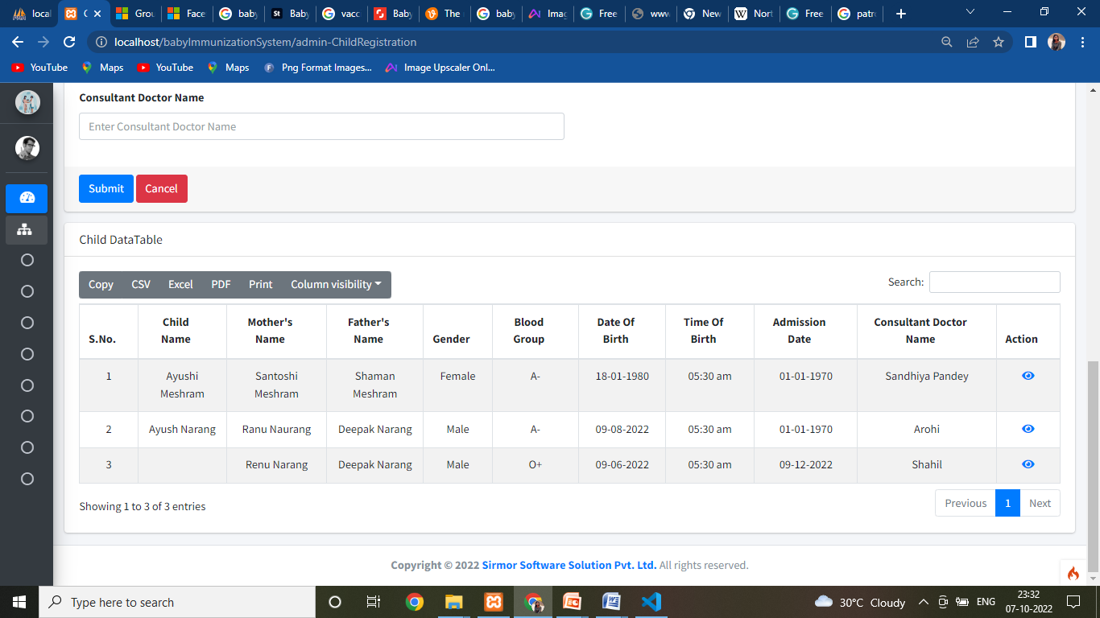
Child Report

Slide 37
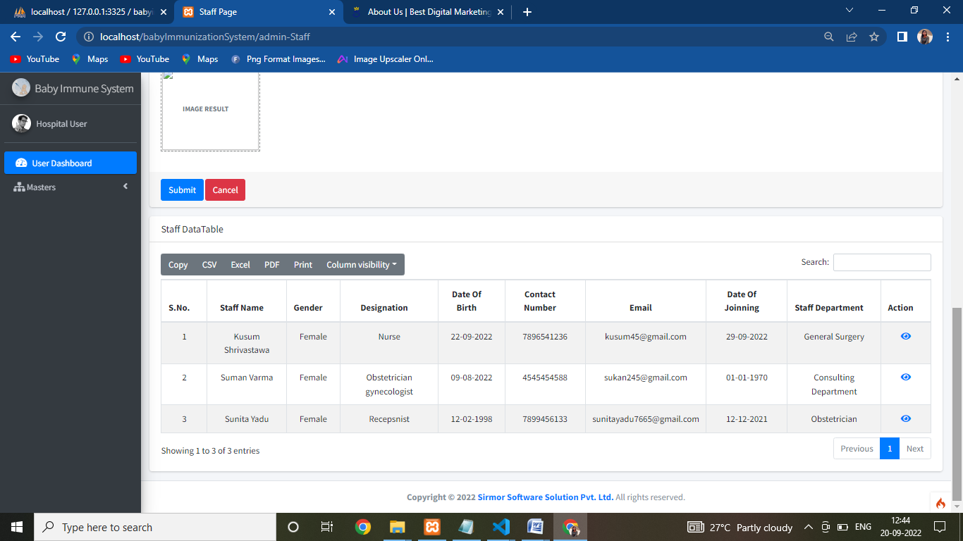
Staff Master Report

Slide 38
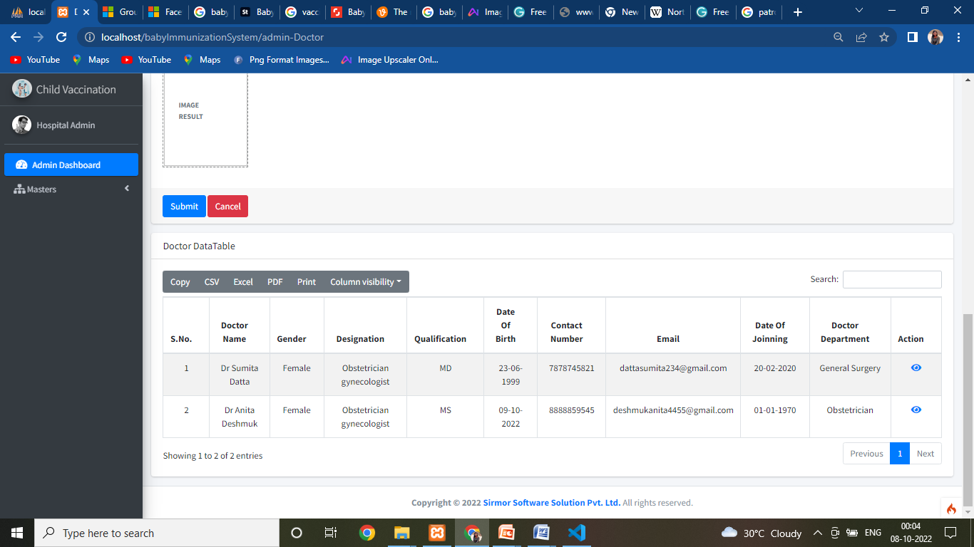
Doctor Master Report

Slide 39
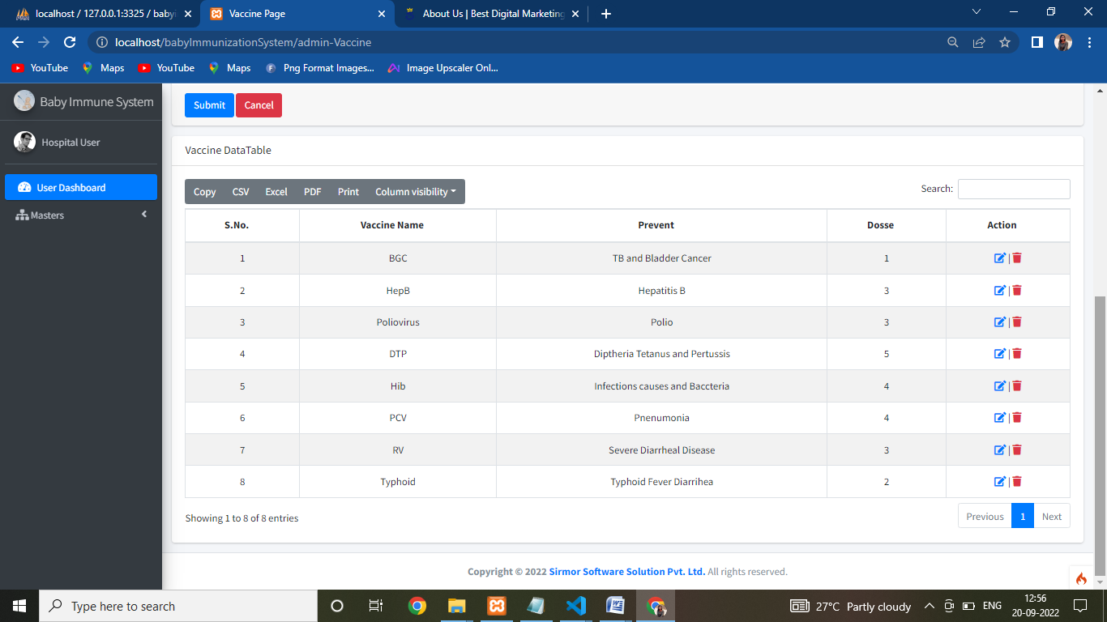
Vaccine Master Report

Slide 40
Advantages
Keeping all the information.
Reduce the manual work.
Can remove unused data.
Automates daily operational workflow.
Automates finances and maintenance.
Decreases chances of misunderstanding.

Slide 41
Disadvantages
This is a web based application, so this need internet facility.
Online payment method is not provided.
Child Parents cannot book online appointment
Data processing can be slow if internet will be slow.

Slide 42
Future Ehansememnt
It is not possible to develop a system that meets all the requirements of the user. User requirements keep changing as the system is being used. Some of the future enhancements that can be done to this system are:
OTP/SMS Notification.
New system provides new functionality.
Online Payment Method.
Online payment can be done from anywhere with any method
Child And hospital Registraion Online
Mobile App
It will also be made in Mobile App
The above mentioned points are the enhancements which can be done to increase the ability and usage of this project.

Slide 43
Conclusion
The MIS for Children Vaccination is user-friendly This System can take care of each member whether it is an Administrator or User .This System will help them to properly manage the Hospital data, Vaccination Schedule. This System is completely secure since every user is provided with user ID and Password so there is no chance of any unauthorised access. So, It will always ensure only valid data is entered and authorised users are able to access the system.
Finally it can be concluded that the overall “THE MIS FOR CHILDREN VACCINATION” Web application is implemented successfully.
Now after the development of “The MIS for Children Vaccination”, maintaining data has become easier as compared to the earlier system.
Management of large amount of data and its integrity has become easy now.
The entry of data will become very easy with accuracy and without redundancy.

Slide 44
Thank You!

